Slide 1
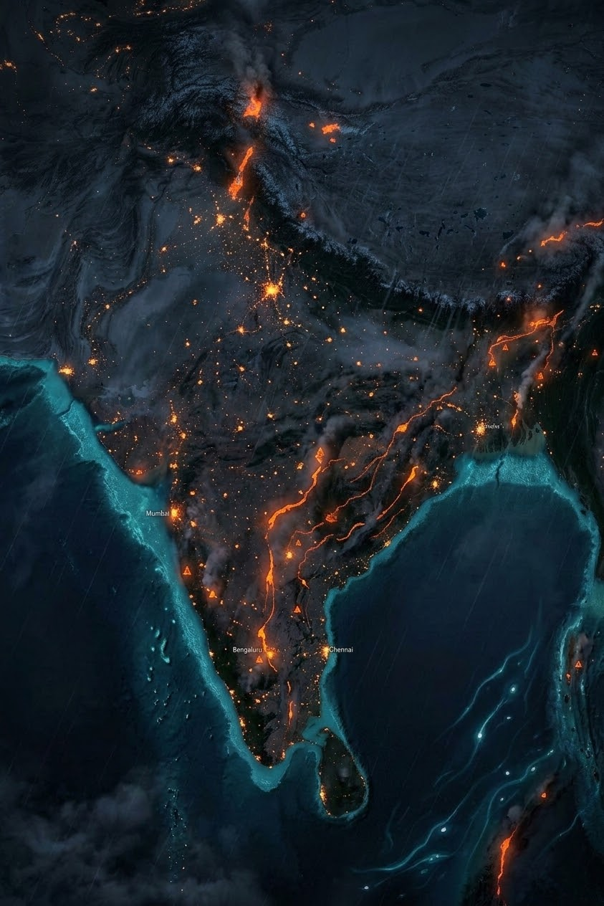
DisasterLink AI
AI‑Powered Disaster Intelligence & Last‑Mile Emergency Communication Platform
Predict. Connect. Protect. Save Every Life.
Government‑grade AI platform co‑designed for NDMA, state disaster authorities, NDRF, ISRO, and industry partners. Smart India Hackathon — finalist‑ready.
SMART INDIA HACKATHON
GOVERNMENT‑GRADE AI

Slide 2
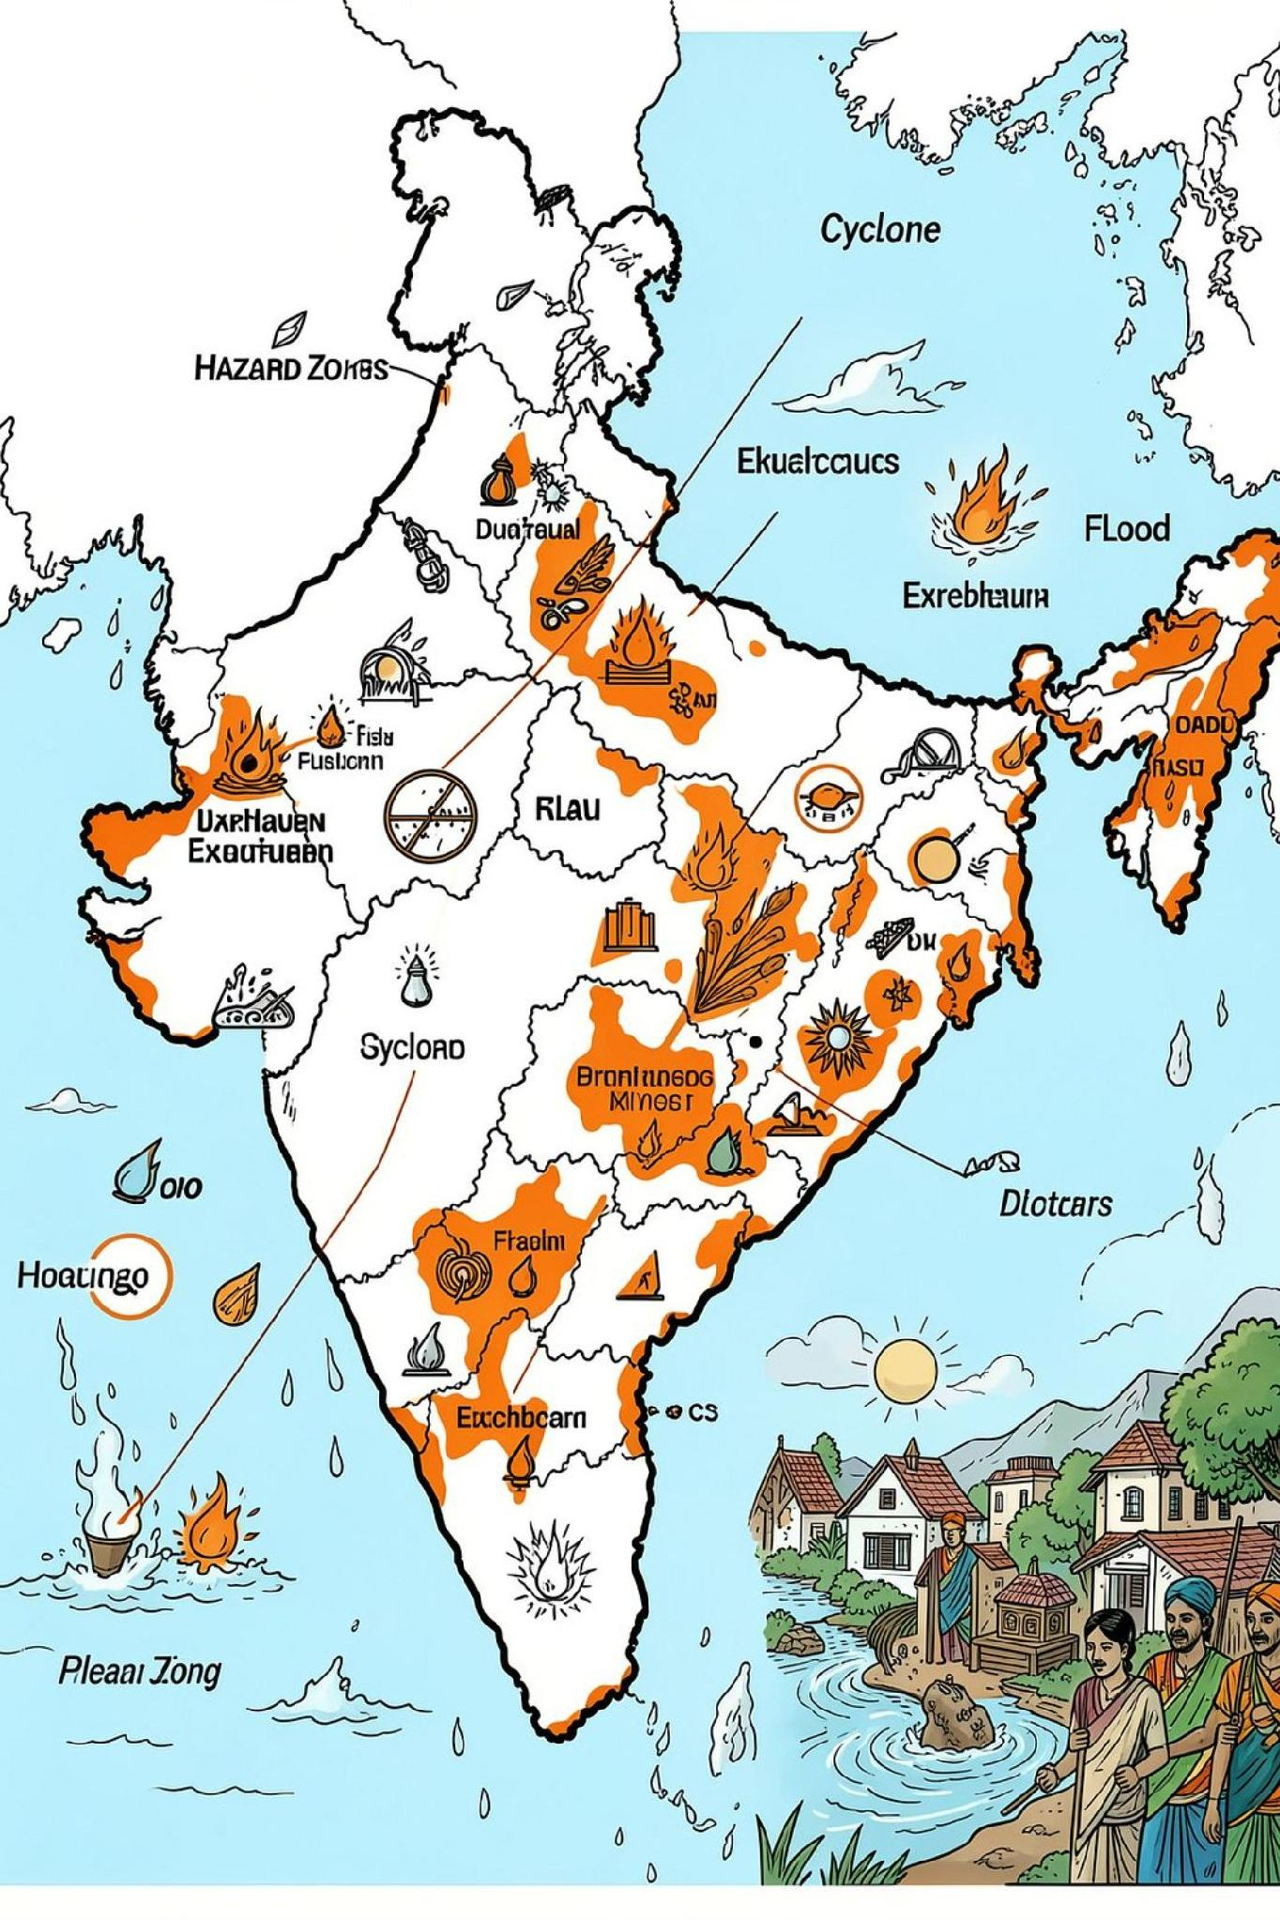

Every Second Counts in a Disaster
Economic Impact
Exposure
Disasters account for roughly ~2% of India’s GDP annually — significant economic and human cost reflected in national reports.
85% of land is vulnerable to one or more natural hazards (flood, cyclone, seismic, drought).
Primary Hazard
Floods ≈ 50% of recorded disasters — rapid onset events with localized impacts and severe last‑mile challenges.
Prediction systems exist; failure is often in last‑mile delivery and accessibility.

Slide 3
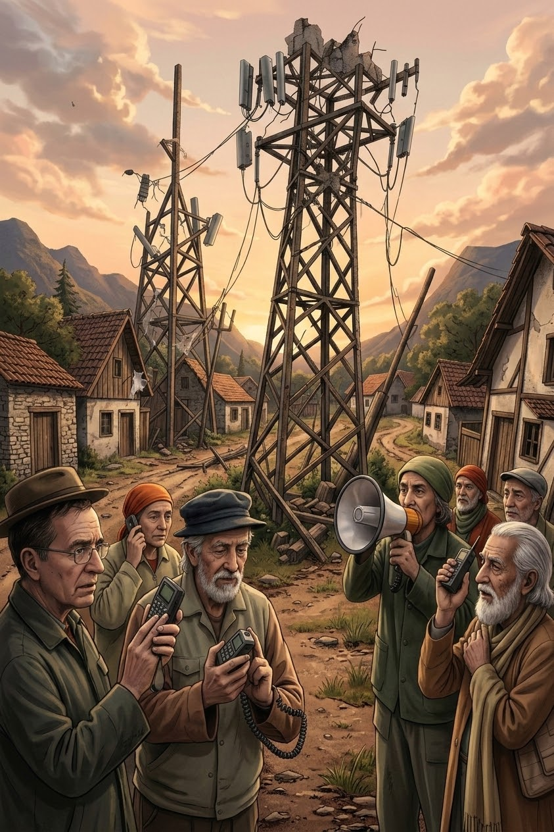




The Real Failure Is Last‑Mile Communication
Never Receive Alerts
Network outages, tower damage or absent infrastructure leave populations blind to warnings.
Alerts Arrive Too Late
Processing delays and manual approvals erode evacuation time windows.
Incomprehensible Alerts
Language, format, and technical jargon prevent understanding — especially for vulnerable groups.
Vulnerable Populations
Elderly, disabled, remote villagers and feature‑phone users are disproportionately affected.
The consequence: forecasts do not translate to timely protective action. DisasterLink AI closes that last‑mile gap.

Slide 4
Traditional Systems vs DisasterLink AI
Traditional Systems
DisasterLink AI
Internet dependent
Manual alerts & approvals
Single‑channel broadcast
Delayed response
Disconnected agencies
No predictive automation
Offline‑ready, multi‑channel
AI‑driven risk scoring & prediction
Real‑time automated broadcasts
Unified inter‑agency coordination
Volunteer & resource intelligence
Pilot‑ready for NDMA/NDRF deployment
Side‑by‑side: DisasterLink AI converts forecasts into comprehensible, timely actions across every connectivity scenario.

Slide 5
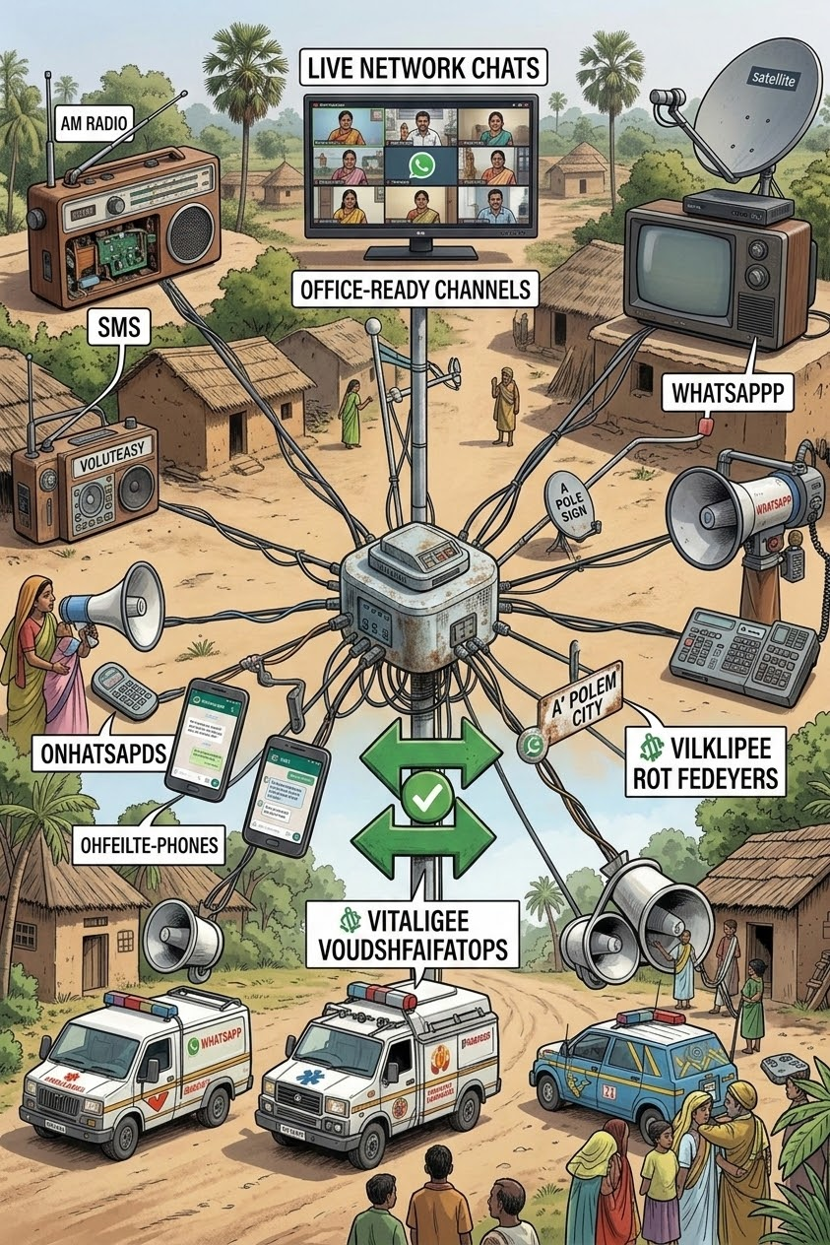


DisasterLink AI: A Unified Disaster Intelligence Platform
One platform connecting NDMA, SDMAs, NDRF, local administration, hospitals, NGOs, volunteers and citizens — with automated, multi‑channel delivery that persists when infrastructure degrades.
AI‑Powered Last‑Mile Communication
Automatic, pre‑verified broadcasts across FM/TV, SMS, voice, messaging apps, village loudspeakers, satellite and vehicle-mounted sirens.
Stakeholder Integration
Unified incident view with role‑based access for government, responders and volunteers — one source of truth for action.

Slide 6

From Detection to Rescue: The AI Workflow
AI Risk Engine
Prediction Model
Detection
Data Ingest
Risk Score
The platform orchestrates detection, risk scoring, automated multi‑channel broadcast and coordinated rescue — preserving human oversight at verification checkpoints to meet policy and legal requirements.
Flood Prediction — Inputs
Flood Prediction — Output
Historical rainfall & river gauge data
Real‑time satellite altimetry
Weather model forecasts
Local sensor / IoT feeds
ML model produces district‑level flood probability maps, time‑to‑impact estimates and evacuation priority lists — feeding the AI broadcast engine for immediate last‑mile delivery.

Slide 7
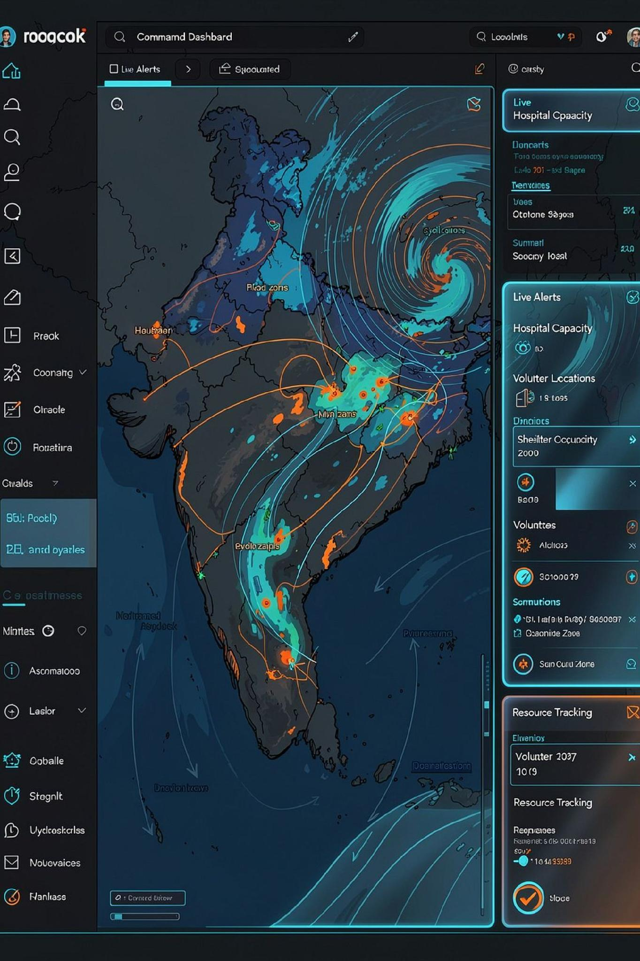

National Disaster Command Dashboard
Live KPIs
Operational Panels
Analytics
Alerts Sent • Coverage (%) • Estimated Lives Impacted • False Alert Rate (low)
Heatmaps of high‑risk districts, response time trends, and post‑event recovery metrics for policy planning.
Emergency Broadcast Status • Hospital Beds • Shelter Occupancy • Resource Locations
Designed for NDMA control rooms — live toggles, layered GIS, and role‑based incident triage.

Slide 8



Built for India. Designed for Everyone.
Technology Stack
Accessibility & Inclusion
Impact & Benefits
AI & ML: Deep Learning, LLMs, CV, TensorFlow
Government
Offline‑First • Feature‑phone & voice support • Regional languages
Faster decisions, data‑driven planning, reduced casualties.
Data: GIS, Remote Sensing, Weather APIs, IoT
Citizens
Large‑font voice alerts, simple action prompts for elderly and visually/hearing impaired users.
Timely, comprehensible alerts — safe, trusted evacuation guidance.
Backend: Cloud, Docker, PostgreSQL, Python
Responders
Frontend: React / Next.js, responsive dashboards
Live tracking, resource visibility, optimized routing and tasking.
Volunteer network integration & local admin overrides for culturally appropriate messaging.

Slide 9

Every Second Matters
When disasters strike, information saves lives. Communication saves communities. AI saves time.
No Citizen is Left Uninformed.
We are seeking partnership with NDMA, state governments, ISRO, NDRF, Smart India Hackathon mentors and strategic industry partners for pilot deployment. Ready for programmatic roll‑out: district pilots, state integrations and national scale‑up.
Call to Action
Approve pilot in 2 districts
Data sharing agreement with ISRO & IMD
Joint technical validation with NIDM
PILOT READY
NDMA / SDMA INTEGRATION
Contact: DisasterLink AI — Pilot & Partnership Team • QR / contact on request

